Slide 1
🞂​ Software Engineering (CSC291)
Lecture 01
Introduction

Slide 2
🞂​ Topics Covered
Professional software development
What is meant by software engineering.
FAQs about software engineering
To introduce software engineering
importance
and to explain its
To set out the answers to key questions about software engineering

Slide 3
​ FAQs on Software Engineering (1)
What is software?
What is software engineering?
What is the difference between software engineering and computer science?
What is the difference between software engineering and system engineering?
What is a software process?
What is a software process model?

Slide 4
FAQs on Software Engineering (2)
What are the costs of software engineering?
What are software engineering methods?
What are the attributes of good software?
What are the key challenges facing software engineering?
What are Stakeholders in Software Engineering?
What are Difficulties and Risks in Software Engineering?

Slide 5
What is Software?
Software: “Computer programs and associated documentation such as requirements, design models and user manuals”.
Software products may be developed for a particular customer or may be developed for a general market.

Slide 6
Software
Program: The program or code itself is definitely included in the software.
Data: The data on which the program operates is also considered as part of the software.
Documentation: Another very important thing that most of us forget is documentation. All the documents related to the software are also considered as part of the software.
So the software is not just the code written in Cobol, Java, Fortran or C++. It also includes the data and all the documentation related to the program.

Slide 7
Types of Software.
Custom
For a specific customer
Generic
Sold on open market
Often called
COTS (Commercial Off The Shelf)
Shrink-wrapped (Refers to store-bought software, implying a standard platform that is widely supported.)
Embedded
Built into hardware
Hard to change

Slide 8
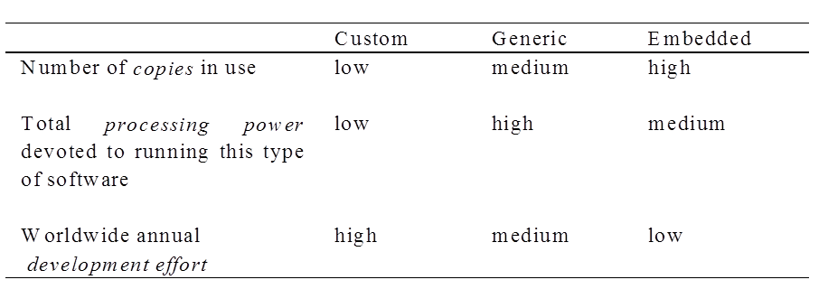
Types of Software
Differences among custom, generic and embedded software

Slide 9
Types of Software
Real time software
Example. Control and monitoring systems
Must react immediately
Safety often a concern
Data processing software
Used to run businesses
Accuracy and security of data are key
Some software have both aspects

Slide 10
Software Products
Generic Products
Stand-alone systems that are marketed and sold to any customer who wishes to buy them.
Examples – PC software such as graphics programs, project management tools; CAD software;
Customized Products
Software that is commissioned by a specific customer to meet their own needs.
Examples – embedded control systems, air traffic control software, traffic monitoring systems.

Slide 11
🞂​ Product Specification
Generic products
The specification of what the software should do is owned by the software developer and decisions on software change are made by the developer.
Customized products
The specification of what the software should do is owned by the customer for the software and they make decisions on software changes that are required.

Slide 12
Software Applications
1. System software: such as compilers, editors, file management utilities
2. Application software: stand-alone programs for specific needs.
3.Engineering/scientific software: Characterized by “number crunching”algorithms. such as
automotive stress analysis, molecular biology, orbital dynamics etc
4. Embedded software resides within a product or system. (key pad control of a microwave oven, digital function of dashboard display in a car)
5. Product-line software focus on a limited marketplace to address mass consumer market.
(word processing, graphics, database management)
6. WebApps (Web applications) network centric software. As web 2.0 emerges, more sophisticated computing environments is supported integrated with remote database and business applications.
7. AI software uses non-numerical algorithm to solve complex problem. Robotics, expert
system, pattern recognition game playing

Slide 13
Changing Nature of Software
Four broad categories of software are evolving to dominate the industry
Web Applications
Mobile Applications
Cloud Computing
Product Line Software

Slide 14
What is Software Engineering?
Definition:
“Software engineering is an engineering discipline that is concerned with all aspects of software production”.
Engineering discipline
Using appropriate theories and methods to solve problems bearing in mind organizational and financial constraints.
All aspects of software production
Not just technical process of development. Also project management and the development of tools, methods etc. to support software production.

Slide 15
Software Engineering Definition
The seminal definition:
[Software engineering is] the establishment and use of sound engineering principles in order to obtain economically software that is reliable and works efficiently on real machines.
The IEEE definition:
Software Engineering: The application of a systematic, disciplined, quantifiable approach to the development, operation, and maintenance of software; that is, the application of engineering to software.
Software engineers should adopt a systematic and organised approach to their work and use appropriate tools and techniques depending on the problem to be solved, the development constraints and the resources available.

Slide 16
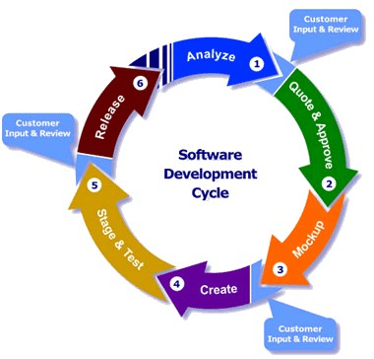

Computer Science Vs. Software Engineering
“Software Engineering is the process of utilizing our knowledge of computer science in effective production of software systems.”
Computer Science | Software Engineering
Computer science is concerned with the theories and methods that underlie computers and software system. | Software engineering is concerned with the practical problems of producing software.

Slide 17
What is the difference between Software Engineering and System Engineering?
“System engineering is concerned with all aspects of computer- based systems development including hardware, software and process engineering. While Software engineering is part of this process concerned with developing the software infrastructure, control, applications and databases in the system”.

Slide 18
Importance of Software Engineering
More and more, individuals and society rely on advanced software systems. We need to be able to produce reliable and trustworthy systems economically and quickly.
It is usually cheaper, in the long run, to use software engineering methods and techniques for software systems rather than just write the programs as if it was a personal programming project. For most types of system, the majority of costs are the costs of changing the software after it has gone into use.

Slide 19
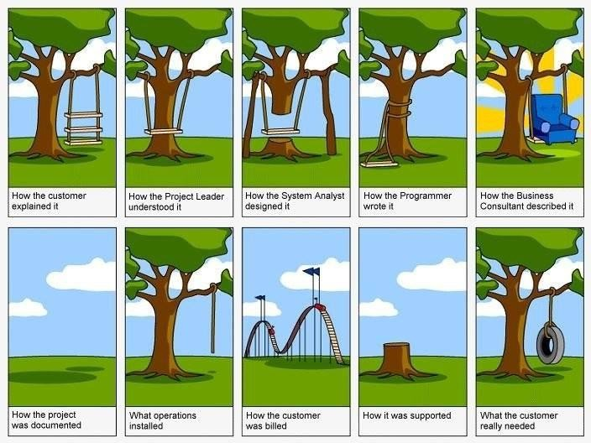
Importance of Software Engineering

Slide 20
What is a Software Process?
Software Process: “The systematic approach that is used in software engineering is sometimes called a software process.”
“A set of activities whose goal is the development or evolution of software”.
Generic activities in all software processes are:
Software specification
Software development:
Software validation:
Software evolution:

Slide 21
Activities in Software Process?
Generic activities in all software processes are:
Software Specification - what the system should do and its development constraints
where customers and engineers define the software that is to be produced and the constraints on its operation
Software Development - production of the software system
where the software is designed and programmed
Software Validation - checking that the software is what the customer wants
where the software is checked to ensure that it is what the customer
requires.
Software Evolution - changing the software in response to changing demands
where the software is modified to reflect changing customer and market requirements.

Slide 22
The Software Process (Simplified)
Feasibility and Planning
Requirements
Design Implementation
Operation and Maintenance

Slide 23
What is a Software Process Model?
Software Process Model: “A simplified representation of a software process, presented from a specific perspective”.
Examples of process perspectives are:
Work flow ➔ what is done when? - sequence of activities;
Data flow ➔ which information flows where?
Role / action ➔ who does what?
Generic process models
Waterfall
Iterative development
Component-based software engineering.

Slide 24
What are the costs of software engineering?
Roughly 60% of costs are development costs, 40% are testing costs. For custom software, evolution costs often exceed development costs.
Costs vary depending on the type of system being developed and the requirements of system attributes such as performance and system reliability.
Distribution of costs depends on the development model that is used.

Slide 25
What are Software Engineering Methods?
Software Engineering Methods: “Structured approaches to software development which include system models, notations, rules, design advice and process guidance".
Model descriptions
Descriptions of graphical models which should be produced
Rules
Constraints applied to system models
Recommendations
Advice on good design practice
Process guidance
What activities to follow

Slide 26
What is CASE?
(Computer-Aided Software Engineering)
CASE: “Software systems that are intended to provide automated support for software process activities”.
CASE systems are often used for method support.
Upper-CASE
Tools to support the early process activities of requirements and design;
Lower-CASE
Tools to support later activities such as programming, debugging and testing.

Slide 27
What are the attributes of good Software?
The software should deliver the required functionality and performance to the user and should be maintainable, dependable and acceptable.
Maintainability
Software must evolve to meet changing needs
Dependability
Software must be trustworthy
Efficiency
Software should not make wasteful use of system resources
Acceptability
Software must accepted by the users for which it was designed. This means it must be understandable, usable and compatible with other systems.

Slide 28
What are the key challenges facing Software
Engineering?
Key challenges are: Heterogeneity, delivery, trust and Legacy systems
Heterogeneity
Developing techniques for building software that can cope with heterogeneous
platforms and execution environments.
Large-scale systems are often distributed and include a mix of hardware and software
Delivery
Developing techniques that lead to faster delivery of software.
There is increasing pressure for ever faster delivery of software
Trust
Developing techniques that demonstrate that software can be trusted by its users.
Legacy systems
Valuable existing systems must be maintained and updated

Slide 29
What are Stakeholders in Software
Engineering?
Stakeholder: A stakeholder is anyone who has a stake in the successful outcome of the project
1. Users
Those who use the software
2. Customers
Those who pay for the software
3. Software developers
4. Development Managers
Note: All four roles can be fulfilled by the same person

Slide 30
What are Difficulties and Risks in Software Engineering?
Complexity and large numbers of details
Uncertainty about technology
Uncertainty about requirements
Uncertainty about software engineering skills
Constant change
Political risks

Slide 31
Software Engineering Fundamentals
Some fundamental principles apply to all types of software system, irrespective of the development techniques used:
Systems should be developed using a managed and understood development process. Of course, different processes are used for different types of software.
Dependability and performance are important for all types of system.
Understanding and managing the software specification and requirements (what the software should do) are important.
Where appropriate, you should reuse software that has already been developed rather than write new software.

Slide 32
Web Software Engineering
The Web is now a platform for running application and organizations are increasingly developing web-based systems rather than local systems
Software reuse is the dominant approach for constructing web-based systems.
When building these systems, you think about how you can assemble them from pre- existing software components and systems.
Web-based systems should be developed and delivered incrementally.
It is now generally recognized that it is impractical to specify all the requirements for such systems in advance.
User interfaces are constrained by the capabilities of web browsers.
Technologies such as AJAX allow rich interfaces to be created within a web browser
but are still difficult to use. Web forms with local scripting are more commonly used.

Slide 33
Web-based Software Engineering
Web-based systems are complex distributed systems but the fundamental principles of software engineering discussed previously are as applicable to them as they are to any other types of system.
The fundamental ideas of software engineering, discussed in the previous section, apply to web-based software in the same way that they apply to other types of software system.

Slide 34
Key Points - Frequently asked questions about
software engineering
Question | Answer
What is software? | Computer programs and associated documentation. Software products may be developed for a particular customer or may be developed for a general market.
What are the attributes of good software? | Good software should deliver the required functionality and performance to the user and should be maintainable, dependable and usable.
What is software engineering? | Software engineering is an engineering discipline that is concerned with all aspects of software production.
What are the fundamental software engineering activities? | Software specification, software development, software validation and software evolution.
What is the difference between software engineering and computer science? | Computer science focuses on theory and fundamentals; software engineering is concerned with the practicalities of developing and delivering useful software.
What is the difference between software engineering and system engineering? | System engineering is concerned with all aspects of computer-based systems development including hardware, software and process engineering. Software engineering is part of this more general process.

Slide 35
Key Points - Frequently asked questions about
software engineering
Question | Answer
What are the key challenges facing software engineering? | Coping with increasing diversity, demands for reduced delivery times and developing trustworthy software.
What are the costs of software engineering? | Roughly 60% of software costs are development costs, 40% are testing costs. For custom software, evolution costs often exceed development costs.
What are the best software engineering techniques and methods? | While all software projects have to be professionally managed and developed, different techniques are appropriate for different types of system. For example, games should always be developed using a series of prototypes whereas safety critical control systems require a complete and analyzable specification to be developed. You can’t, therefore, say that one method is better than another.
What differences has the web made to software engineering? | The web has led to the availability of software services and the possibility of developing highly distributed service-based systems. Web-based systems development has led to important advances in programming languages and software reuse.

Slide 36
Essential attributes of good software
Product characteristic | Description
Maintainability | Software should be written in such a way so that it can evolve to meet the changing needs of customers. This is a critical attribute because software change is an inevitable requirement of a changing business environment.
Dependability and security | Software dependability includes a range of characteristics including reliability, security and safety. Dependable software should not cause physical or economic damage in the event of system failure. Malicious users should not be able to access or damage the system.
Efficiency | Software should not make wasteful use of system resources such as memory and processor cycles. Efficiency therefore includes responsiveness, processing time, memory utilisation, etc.
Acceptability | Software must be acceptable to the type of users for which it is designed. This means that it must be understandable, usable and compatible with other systems that they use.

Slide 37
Key Points
Software engineering is an engineering discipline that is concerned with all aspects of software production.
Essential software product attributes are maintainability, dependability and security, efficiency and acceptability.
The high-level activities of specification, development, validation and evolution are part of all software processes.
The fundamental notions of software engineering are universally applicable to all types of system development.
There are many different types of system and each requires appropriate software engineering tools and techniques for their development.
The fundamental ideas of software engineering are applicable to all types of software system.

Slide 38

THANK YOU

Slide 39

THANK YOU

